Slide 1








[Episode.9 ]
Fire Safety in karaoke
Disabled
Woman
Elderly
Foreigner

Slide 2



Contents
[Episode.9]
Fire Safety in Karaoke
Fire Weakness of Karaoke _ 2p
Fires in Publicly Used Establishments _ 3p
Causes of Karaoke Fires_ 6p
Fire Safety & Evacuation Tips _ 11p
Disabled
Woman
Elderly
Foreigner

Slide 3

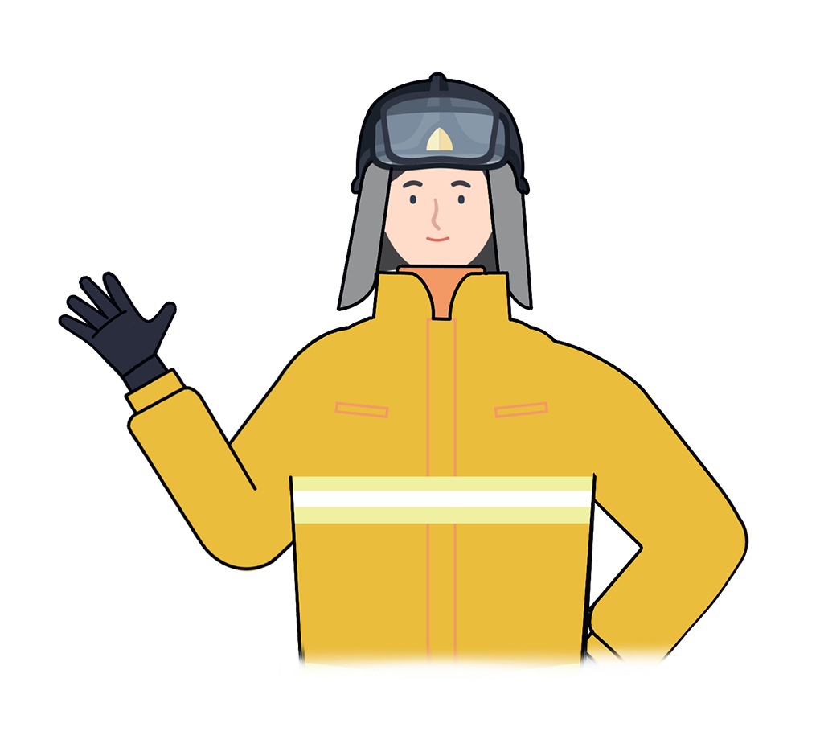
1
Fire Weakness of Karaoke
“
Due to the loud music and singing, most people could not recognize the signs of a fire, causing many lives losses when a fire occurs.
Find the 2 exit doors every time you enter a karaoke bar
If the screen is off or upon hearing a fire notification, calm down and evacuate immediately
“
Disabled
Woman
Elderly
Foreigner

Slide 4
2
Fires in Publicly Used Establishments
Classification | All |  | General Buildings |  | Publicly Used Establishments
 | Fires | Casualties | Fires | Casualties | fires | Casualties
Total | 216,498 | 11,089 | 213,398 | 10,820 | 3,101 | 269
 | 100% | 100% | 98.57% | 97.52% | 1.43% | 2.48%
2018 | 42,337 | 2,594 | 41,773 | 2,477 | 565 | 117
2017 | 44,178 | 2,197 | 43,599 | 2,175 | 579 | 22
2016 | 43,413 | 2,024 | 42,700 | 1,964 | 713 | 60
2015 | 44,435 | 2,093 | 43,870 | 2,058 | 565 | 35
2014 | 42,135 | 2,181 | 41,517 | 2,154 | 608 | 27
The cases of fires accumulated for 5 years are 3,101(for 1.43%) of the total number of fires
The 269 casualties represent 2.48% of the total casualties of 2,954 which means the casualties proportion in publicly used establishments is relatively very high.
Disabled
Woman
Elderly
Foreigner

Slide 5
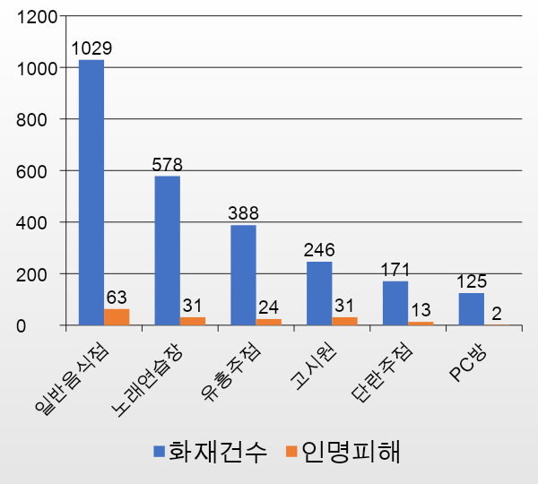
2
Fires in Publicly Used Establishments
“
The number of fires in publicly used establishments is less than in restaurants or stores but the number of casualties is many times higher
The reason is that roads and buildings are narrowly built
Karaoke
Gosiwon
Karaoke Bar
Internet cafe
restaurant
General Bars
”
Number
of fires
Casualties
Disabled
Woman
Elderly
Foreigner

Slide 6
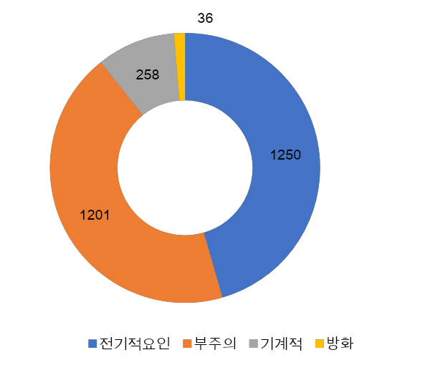
2
Fires in Publicly Used Establishments
“
Caused due to electricity 1,250
cases (40.3%)
Caused of negligence 1,201 cases
(38.7%)
Negligence : cigarettes, cooking,
playing with fire, etc.
원인별
Cause of fires
”
Electrical factors Negligence Mechanical Arson
Disabled
Woman
Elderly
Foreigner

Slide 7
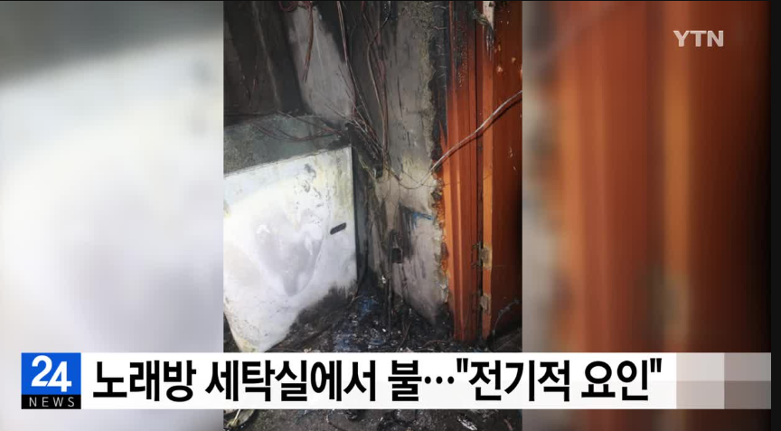
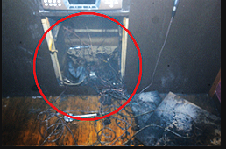
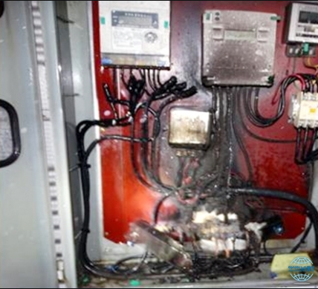
Causes of Karaoke Fires
3
Cause by electricity
Due to errors in assembling or outdated gramophone equipment
Due to electrical overload
Open cord or power leakage due to moisture and rain
Disabled
Woman
Elderly
Foreigner

Slide 8
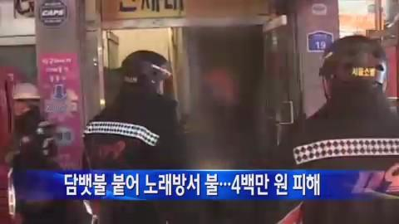
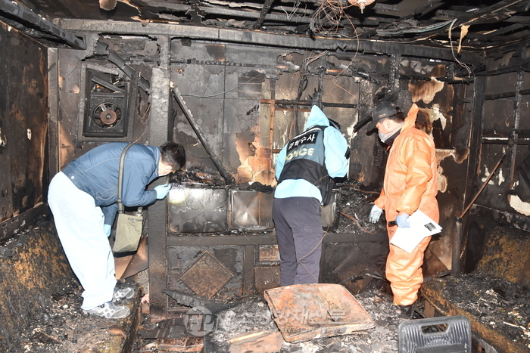
Causes of Karaoke Fires
3
Due to cigarette butts
Throw cigarette butts in karaoke rooms
Smoking when drunk and not aware of a fire
Throw cigarette butts into a paper bag when the cigarette butts are not completely off, causing a fire
Disabled
Woman
Elderly
Foreigner

Slide 9
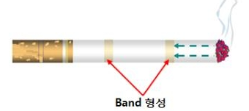
Causes of Karaoke Fires
3
Dispose of cigarette butts can cause a fire
In 2015, we started importing cigarettes with the
body made of non-combustible materials
Fire-safe cigarette will automatically turn off when
lighting it without smoking
Sell after receiving a certificate for its ability to reduce
the likelihood of causing a fire
What is the Fire-safe Cigarette
Disabled
Woman
Elderly
Foreigner

Slide 10
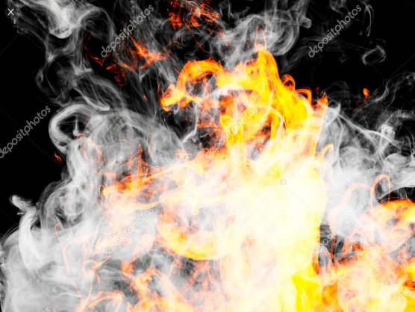
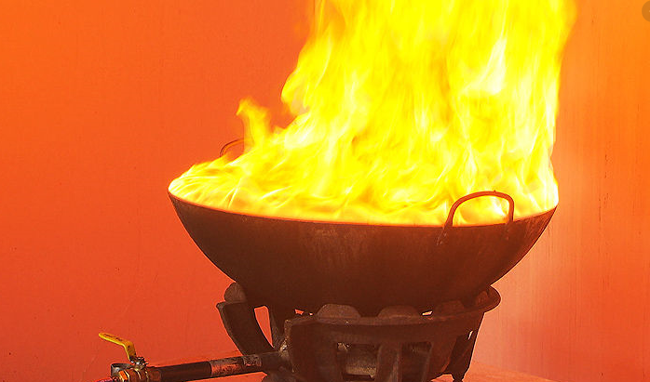
Causes of Karaoke Fires
3
Every material has its flash point lower than ignition point
Flash Point
Ignition Point
The lowest temperature at which a substance vaporises into a gas, which
can be ignited with the introduction
of an external source of fire
The lowest temperature which ignites without the help of any external flame or ignition source
Disabled
Woman
Elderly
Foreigner

Slide 11
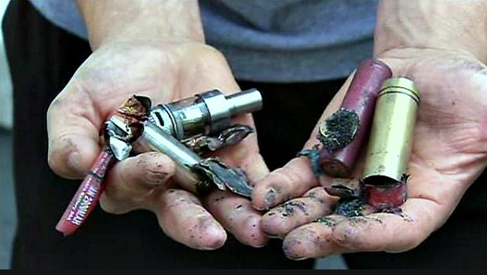
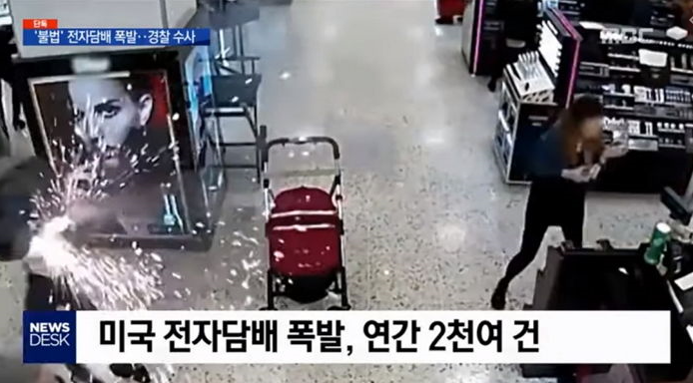
Causes of Karaoke Fires
3
“Electronic cigarettes cannot cause fire and are harmless?
Electronic cigarettes (having batteries) can cause an explosion
Store the battery by its own storage device
Read the battery usage instructions and safety rules when using electronic cigarettes
Do not charge when sleeping or while going out!
Disabled
Woman
Elderly
Foreigner

Slide 12
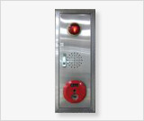
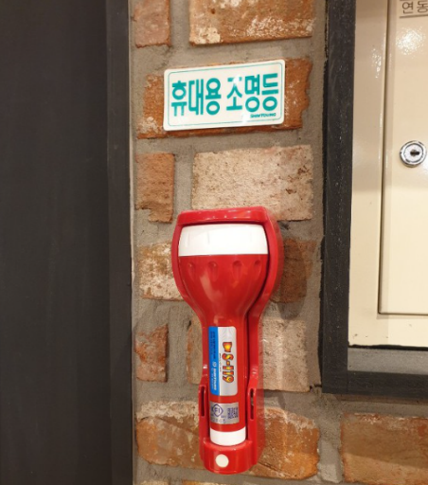
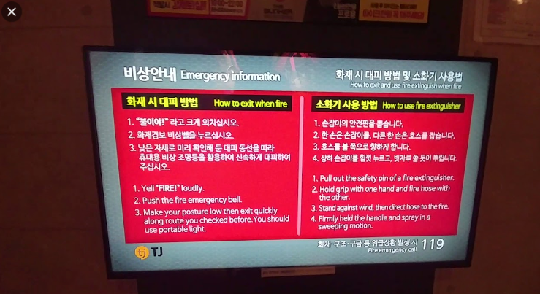
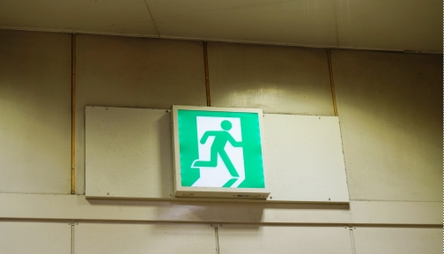
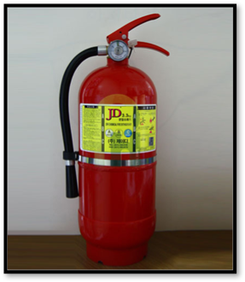
Fire Safety & Evacuation Tips
4
(Alarm system)
(Portable light)
(Emergency Instruction)
(Exit Sign)
(Fire extinguisher) cháy)
Install automatic sound blocking devices to prevent fires
Identify more than 2 exits when entering into a karaoke room
Locate portable flashlight and use when there is power failure
Disabled
Woman
Elderly
Foreigner

Slide 13
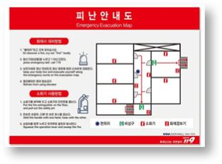
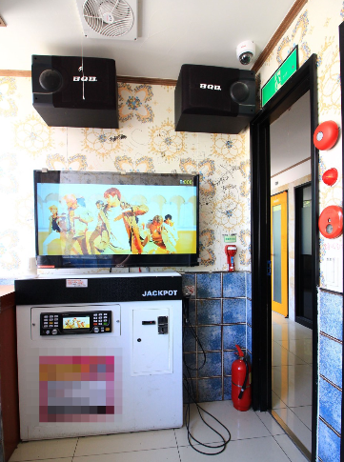
Fire Safety & Evacuation Tips
4
Evacuation map
출입구 및 피난안내도 확인하기
Identify the exit and evacuation map
소방시설 위치 확인하기
Identify the location of firefighting facilities
대피로 2곳 이상 생각해 두기
Think of more than two routes for evacuation
Disabled
Woman
Elderly
Foreigner

Slide 14
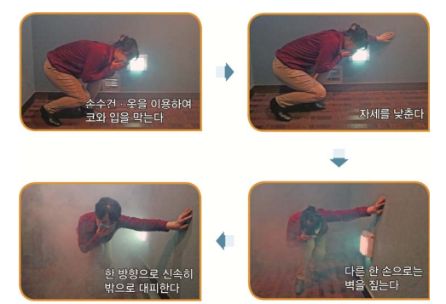
Fire Safety & Evacuation Tips
4
“
An important note to remember is that when you are in a fire, do not panic or else you will breathe in gas and smoke
Cover your nose and mouth, lower your body and act calmly
Use handkerchief clothes to cover your nose and mouth
Lower posture
”
Evacuate quickly in one direction
The other hand points to the wall.
Disabled
Woman
Elderly
Foreigner

Slide 15
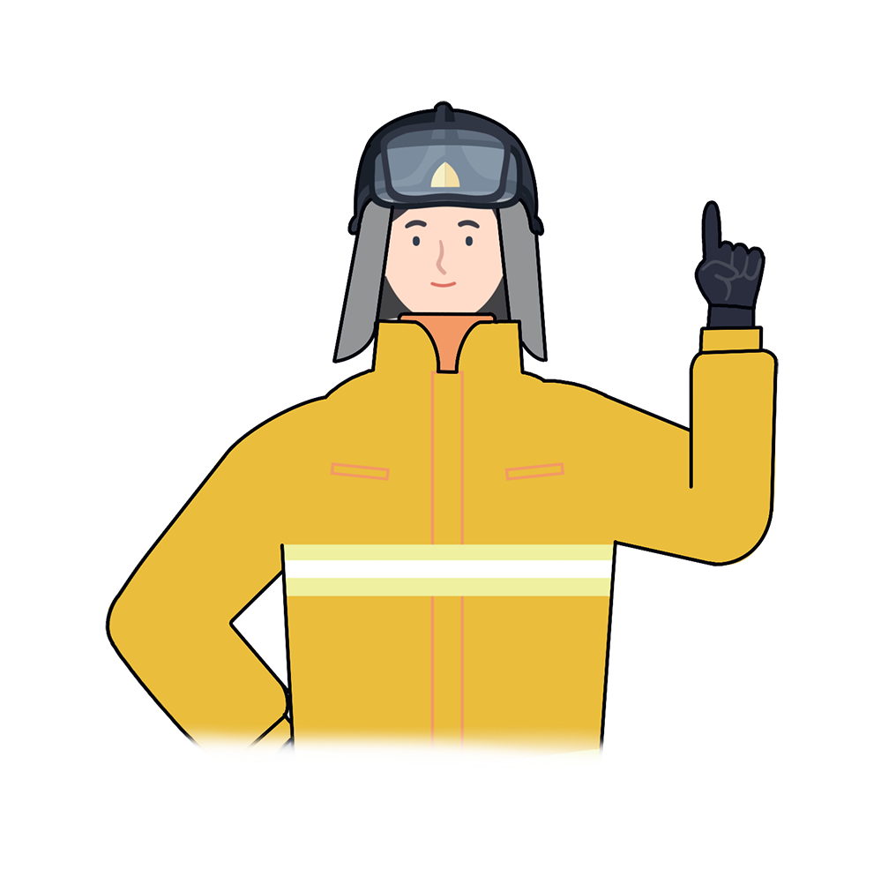
*
Key Points for Fire Safety
“
With the crowded nature of public places such as karaoke bars, we need to calmly handle and escape when there is a fire.
“
Disabled
Woman
Elderly
Foreigner

Slide 16

Fire Safety in karaoke
Fire safety training is the foundation for a safe society and happy people

