Slide 1








[Episode.10 ]
Camping Site
Fire Safety
Disabled
Woman
Elderly
Foreigner

Slide 2



Contents
[Episode.10 ]
Camping Site Fire Safety
1. Use Campsite Safely_ 2p
2. Campsite Safety Tips_ 5p
3. What To Do In Case Of A Fire?_ 10p
Disabled
Woman
Elderly
Foreigner

Slide 3

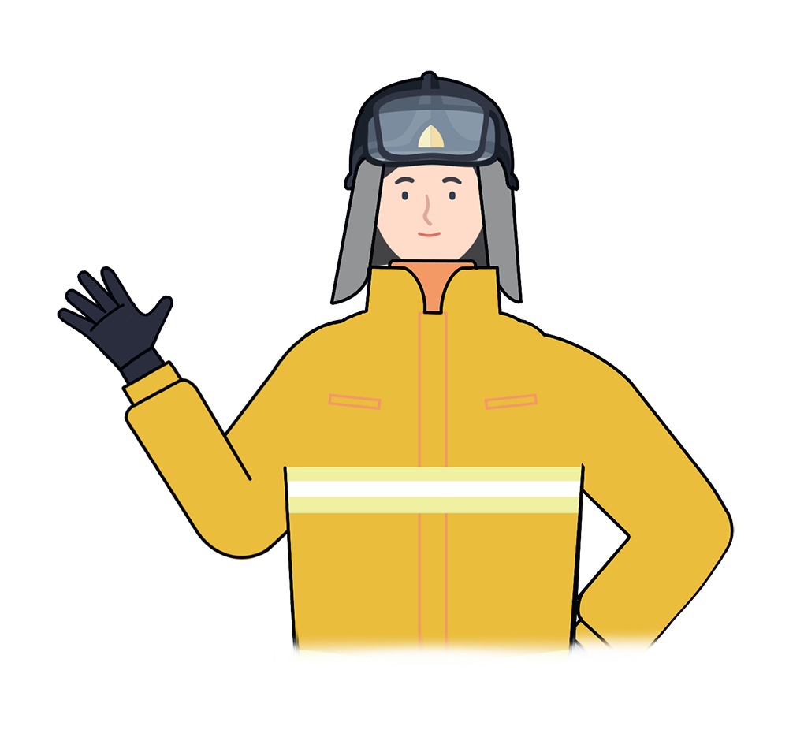
Use Campsite Safely
1
“
Increase in GDP leads to an increase in people's recreational demands such as camping.
In recreation activities, we must not forget the fire safety rules
“
Disabled
Woman
Elderly
Foreigner

Slide 4
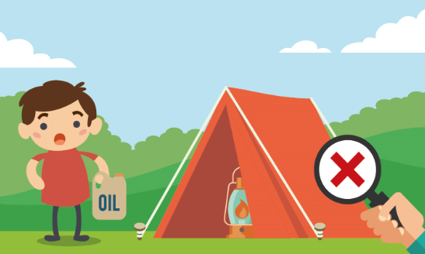
Use Campsite Safely
1
Accidents often happen when camping
1. Poisonned by gas when using a heater in the tent
2. Slip while camping near the brook
3. Fire when burning a campfire or using electrical
appliances
4. Bitten by an insect or mosquito
Disabled
Woman
Elderly
Foreigner

Slide 5
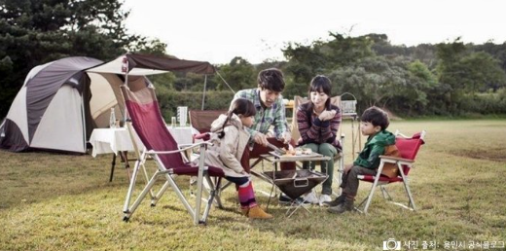
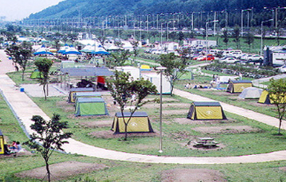
Use Campsite Safely
1
What to prepare for a safe camp?
1. Go to the registered campsite
Number of registered campsites nationwide - more than 2,200
There are many illegal campsites so we should check them on the Gocamping page of the Korean Tourism Association
Disabled
Woman
Elderly
Foreigner

Slide 6
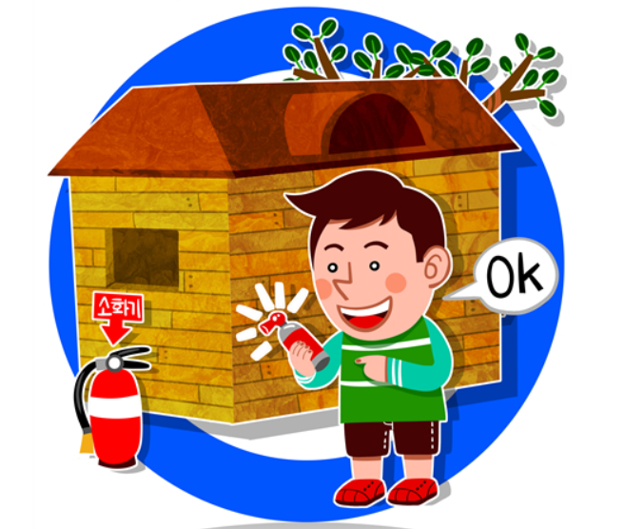
Campsite Safety Tips
2
What to prepare for a safe camp?
2. Carefully prepare for the camp, check the weather and terrain
Use pesticide spray with the right dose so as not to affect the surrounding air
When burning campfire, one need to spray water around it first
Check the location of fire extinguishers in the campsite
Disabled
Woman
Elderly
Foreigner

Slide 7
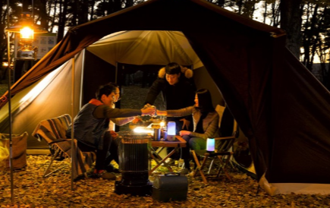
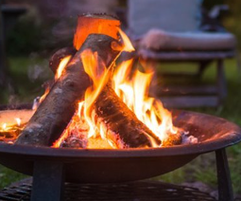
Campsite Safety Tips
2
What to prepare for a safe camp?
- Cooking or burning in a tent is strictly forbidden
When cooking, using a pot or pan that is too large on a travel gas stove can put pressure on the gas cylinder causing an explosion
Check carefully around for the signs of potential fire before going to bed
Making a campfire or using fire beyond the reach of children
Disabled
Woman
Elderly
Foreigner

Slide 8
Campsite Safety Tips
2
“
Fires in a campfire area can cause wildfires
On windy dry weather, one should pay special attention when using fire
“
Disabled
Woman
Elderly
Foreigner

Slide 9
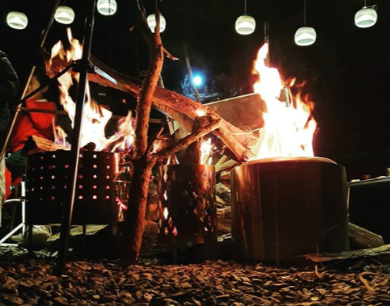
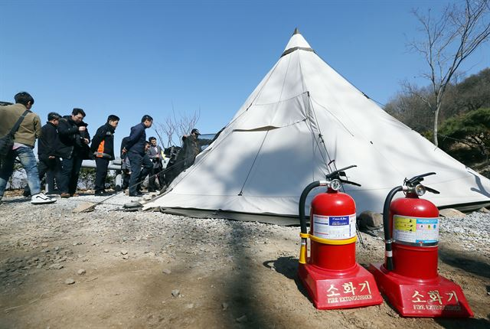
3
What To Do In Case Of A Fire?
1) Immediately notify everyone when there is a fire
2) Put out the fire immediately with a fire extinguisher
Disabled
Woman
Elderly
Foreigner

Slide 10
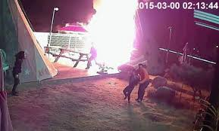

3
What To Do In Case Of A Fire?
3) If the fire is not put out, quickly escape
(Check the emergency exit first)
4) Call 119
Disabled
Woman
Elderly
Foreigner

Slide 11
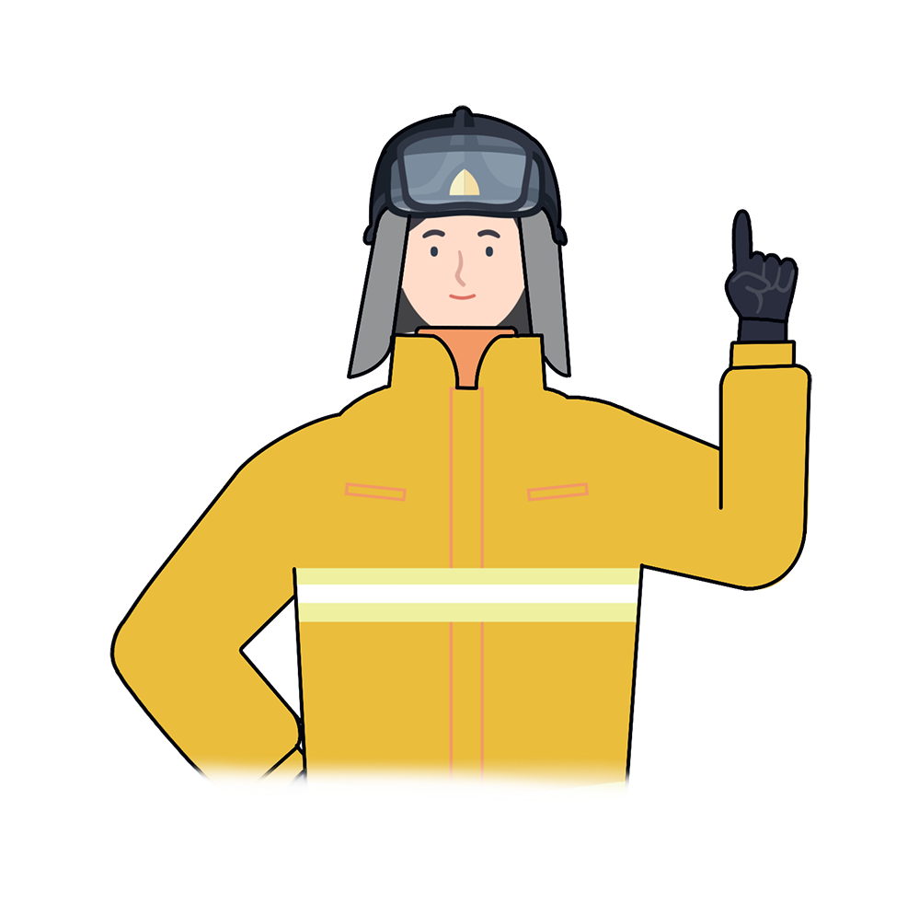
*
Key Points for Fire Safety
“
Travel and camping are fun
Don't let this fun turn into a fire, always follow camping rules and safety instructions.
Have a nice camping trip
“
Disabled
Woman
Elderly
Foreigner

Slide 12

Camping Site Fire Safety
Fire safety training is the foundation for a safe society and happy people

